Slide 1
Data Science Capstone
04/06 Team Update
Sam Speake

Slide 2
Domain Team
Statistics Team
Polishing of mitigation methodologies and annotated bibliography documents
Uploaded to GitHub, along with all articles
Decided on the statistical parity test
Only drawback is that it only looks at group fairness, not individual
Created a document which gives context and instructions for the development team to implement the test

Slide 3
Development Team
RShiny dashboard has been refined to match Dr. Guha’s feedback
Wholistic group and individual outputs in github from the model with and without race included
Separate data cleaning file in GitHub created
Data no longer has to be re-cleaned on runs
Forces accuracy across models
Data understanding file updated

Slide 4
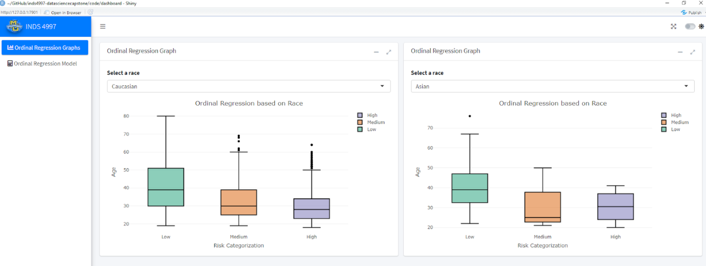

Slide 5
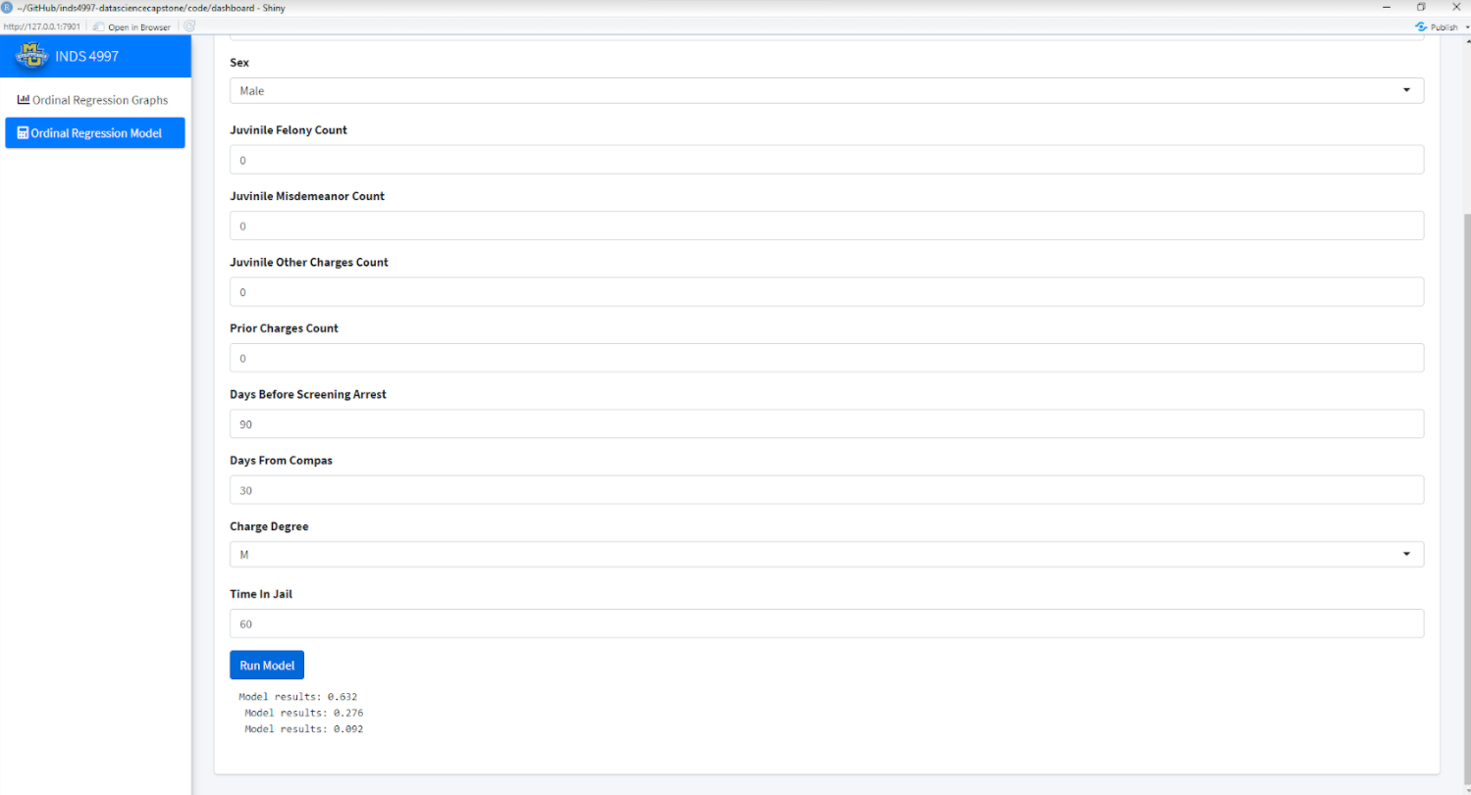

Slide 6
Moving Forward
Move the development team’s focus to be entirely on creating the RShiny dashboard as it will be the forefront of what we have to show
Have the statistics team take over a lot of model development rather to reduce bottleneck and speed up production
The model development seems to fit more under statistics anyways
This will be more efficient than our current pipeline
Have Connor set up a meeting with the statistics team to provide a transfer of knowledge

